Slide 1
Recent Additions
Outlier rejection
Reduced measurement time
Exponential timepoints
File saving
Real-time Probe & dA

Slide 2
File Chart
Main
WorkerThread
IronPython
Signals
Sockets
Heatmap Window
Probe Window
dA Window
camera
Heatmap
Heatmap_Interface
Plot_calculations
Start Popup
Exponentialsteps
Wavelength Popup
GraphThread

Slide 3
Heatmap
Heatmap Window
Combining elements
Updating GUI elements (sliders/lines)
Heatmap
Heatmap + adjacent graphs
Heatmap_Interface
Input measurements
Exponential_steps
Calculations for exponential timesteps
Evenly spaced up to -1ps
-1 to 0 = mirrored 0 to 1 ps
Logarithmic after 1 ps
Heatmap Window
Heatmap
Heatmap_Interface
Exponential_steps

Slide 4
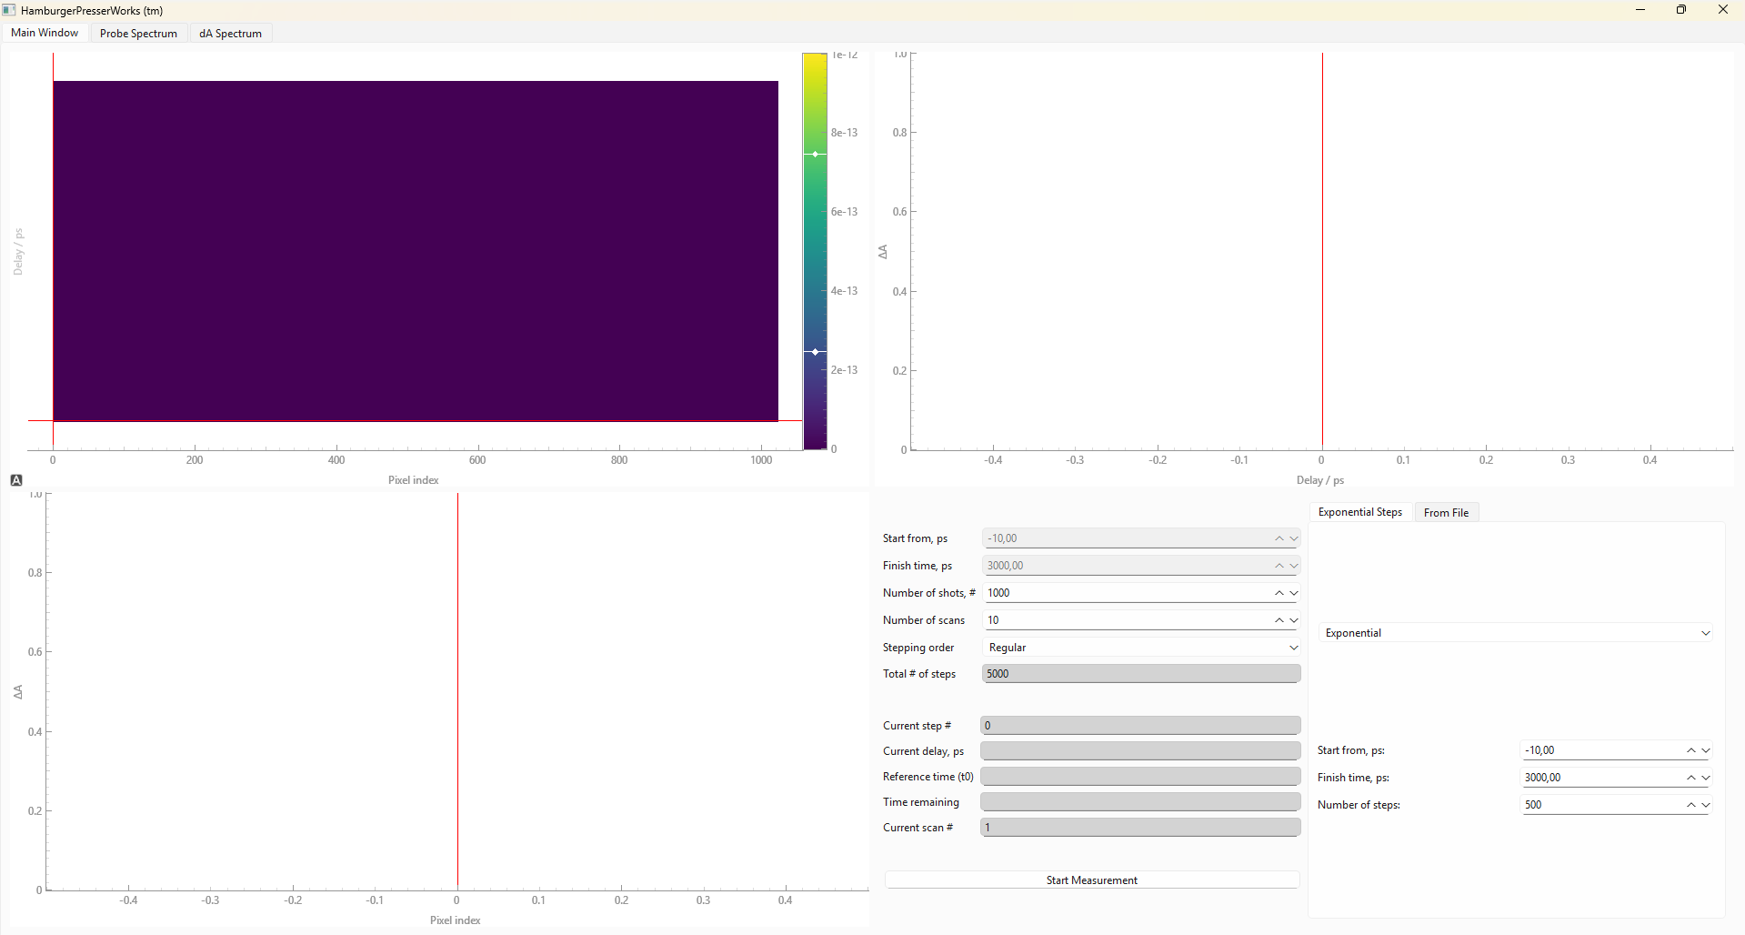
Heatmap Window

Slide 5
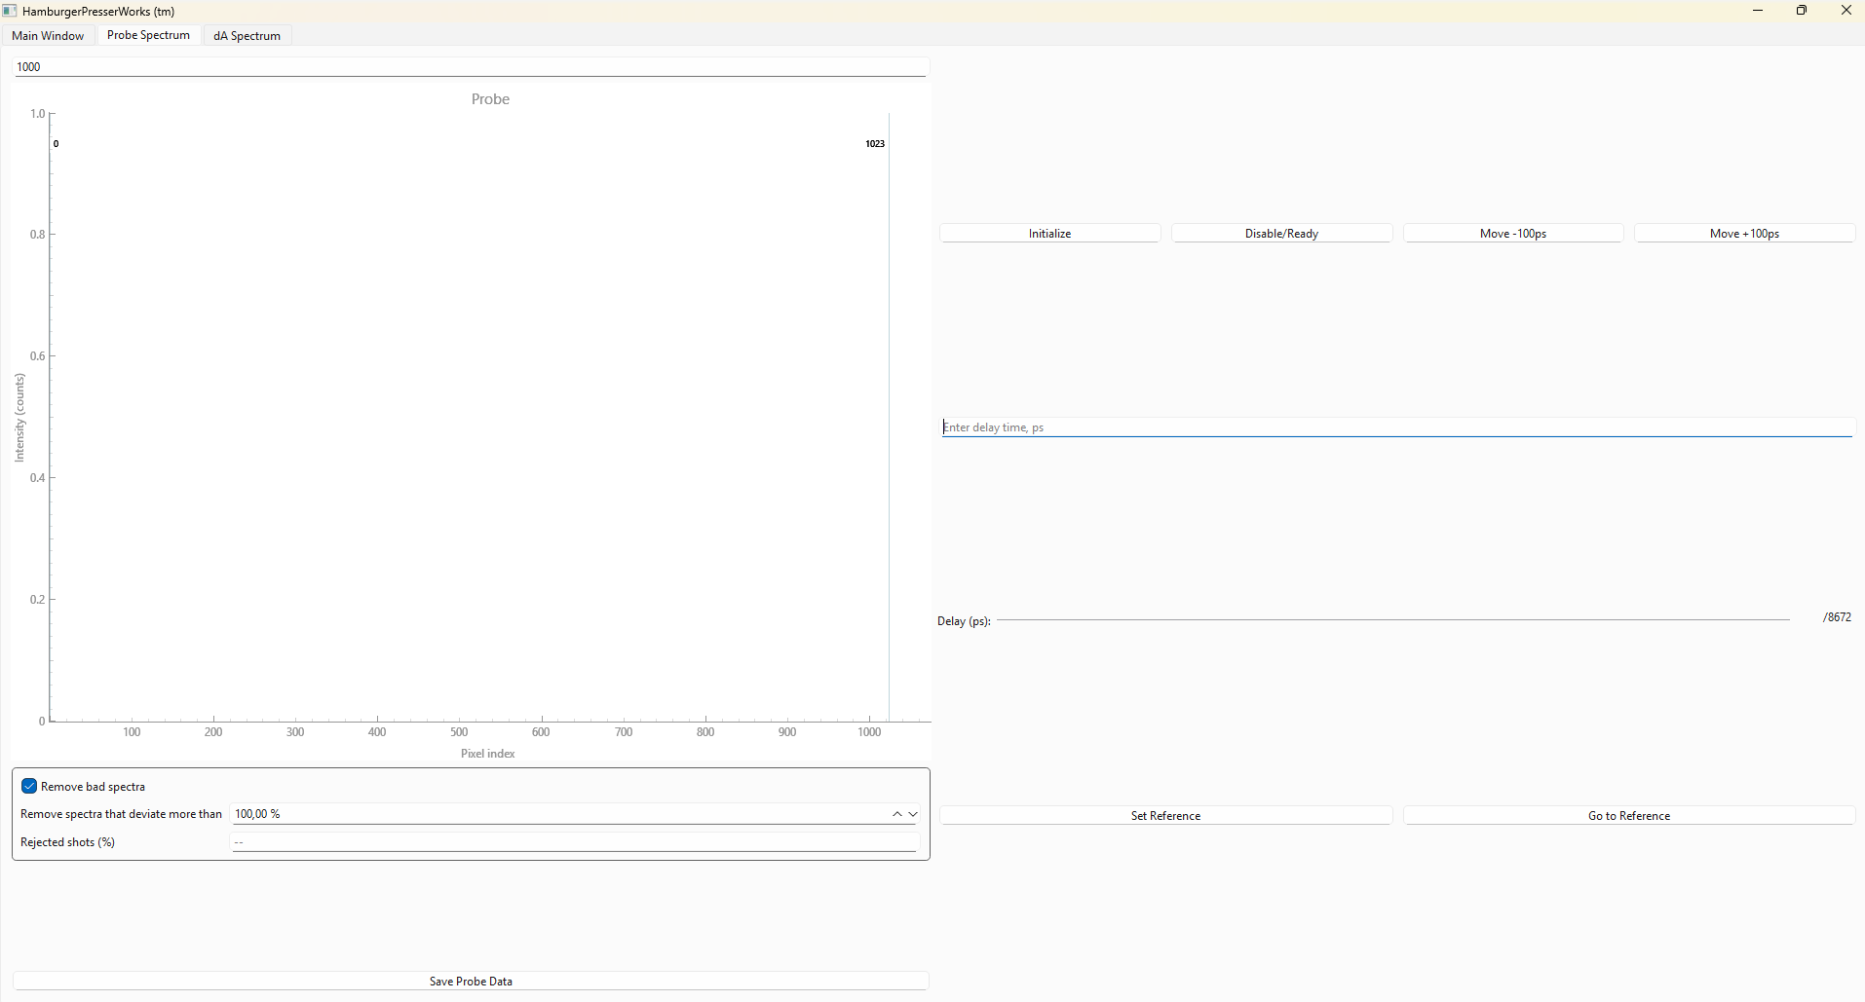
Probe Window

Slide 6
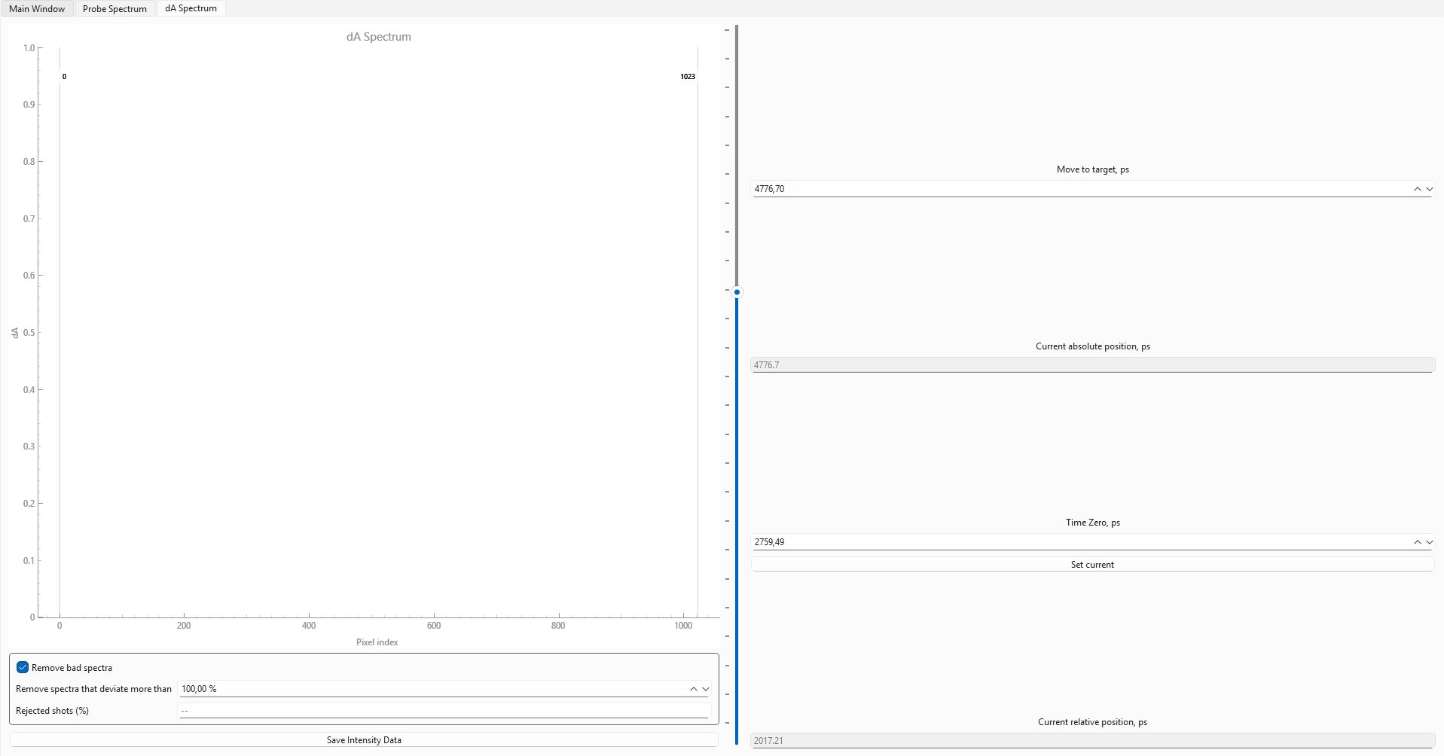
dA Window

Slide 7
Backend
WorkerThread
Handling inputs
Measurement calculations
Camera
Using camera
Plot_calculations
dA
Probe
IronPython
Moving Delay Stage
WorkerThread
IronPython
Sockets
camera
Plot_calculations

Slide 8
Sockets
Server & Client
Host & Port
Server listens for client
Code block
Server
Client

Slide 9
Code Flow
IronPython
Start Measurement
Connection
Main Window (WorkerProcess)
WorkerThread
List
IronPython
Calcs
WorkerThread
Updates
Next Step
IronPython
GUI
Calcs

Slide 10
Signals
Communication between threads
Emissions
Connections
Main
WorkerThread
Signals

Slide 11
Signal Flow
Heatmap window
Camera_gui
Probe window (DLS)
dA Window:
run_command
Main Interface:
trigger_worker
parsed_content
DLS Window:
run_command
ProbeThread:
Probe_update
dA_update
dA Window
Main_window
WorkerThread

Slide 12
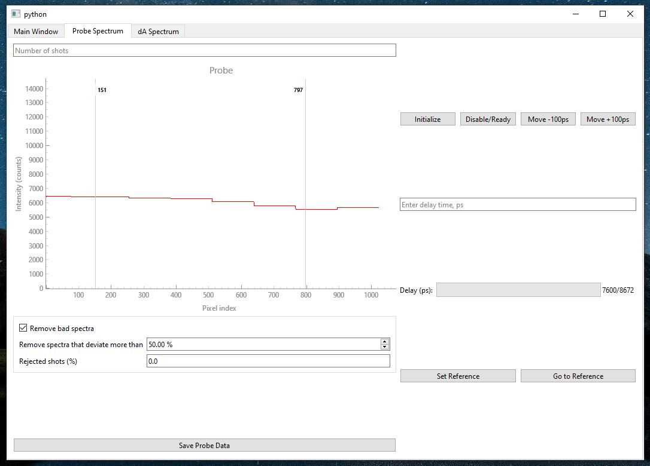
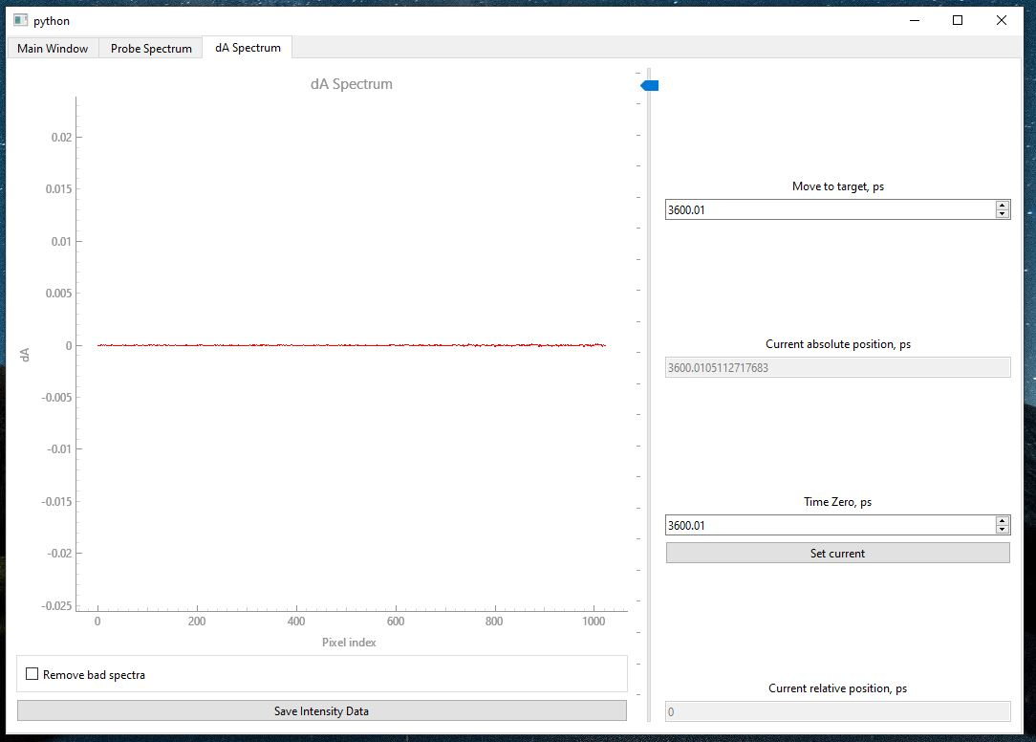
Real time probe & dA
At start-up 1000 shots
Adjust shots
Outlier rejection for probe & dA

Slide 13
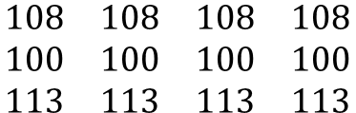
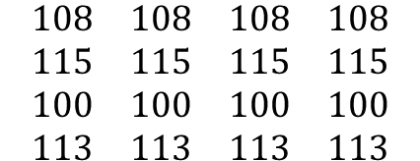
Outlier rejection probe
Overall average 104,50
Allowed deviation 5%
Allowed range [94,50-114,95]
Row average
108
115
100
113
$$\begin{matrix}108 & 108 & 108 & 108 \\ 115 & 115 & 115 & 115 \\ 100 & 100 & 100 & 100 \\ 113 & 113 & 113 & 113\end{matrix}$$
✅
❌
✅
✅
$$\begin{matrix}108 & 108 & 108 & 108 \\ 100 & 100 & 100 & 100 \\ 113 & 113 & 113 & 113\end{matrix}$$

Slide 14


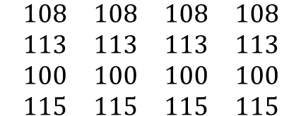
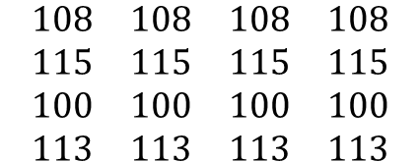
Overall average 104,50
Allowed deviation 5%
Allowed range [94,50-114,95]
Outlier rejection dA
Overall average 104,50
Allowed deviation 5%
Allowed range [94,50-114,95]
Row average
108
115
100
113
Row average
108
113
100
115
$$\begin{matrix}108 & 108 & 108 & 108 \\ 115 & 115 & 115 & 115 \\ 100 & 100 & 100 & 100 \\ 113 & 113 & 113 & 113\end{matrix}$$
✅
$$\begin{matrix}108 & 108 & 108 & 108 \\ 113 & 113 & 113 & 113 \\ 100 & 100 & 100 & 100 \\ 115 & 115 & 115 & 115\end{matrix}$$
✅
❌
✅
✅
✅
✅
❌
$$\begin{matrix}108 & 108 & 108 & 108 \\ 100 & 100 & 100 & 100\end{matrix}$$
$$\begin{matrix}108 & 108 & 108 & 108 \\ 100 & 100 & 100 & 100\end{matrix}$$

Slide 15


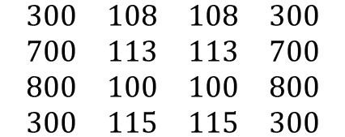
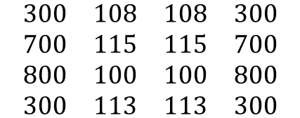
Outlier rejection dA with range
Overall average 109
Allowed deviation 5%
Allowed range [103,55-114,45]
Row average
108
115
100
113
Row average
108
113
100
115
$$\begin{matrix}300 & 108 & 108 & 300 \\ 700 & 115 & 115 & 700 \\ 800 & 100 & 100 & 800 \\ 300 & 113 & 113 & 300\end{matrix}$$
✅
$$\begin{matrix}300 & 108 & 108 & 300 \\ 700 & 113 & 113 & 700 \\ 800 & 100 & 100 & 800 \\ 300 & 115 & 115 & 300\end{matrix}$$
✅
❌
✅
✅
✅
✅
❌
$$\begin{matrix}300 & 108 & 108 & 300 \\ 800 & 100 & 100 & 800\end{matrix}$$
$$\begin{matrix}300 & 108 & 108 & 300 \\ 800 & 100 & 100 & 800\end{matrix}$$

Slide 17
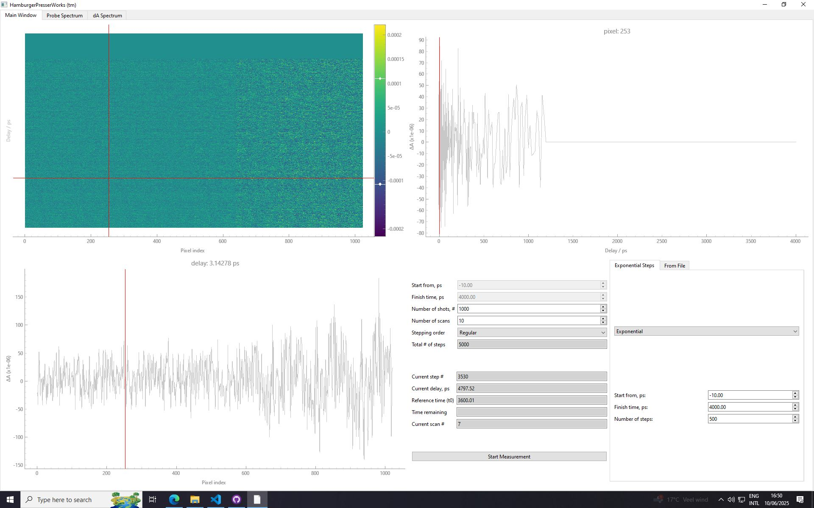
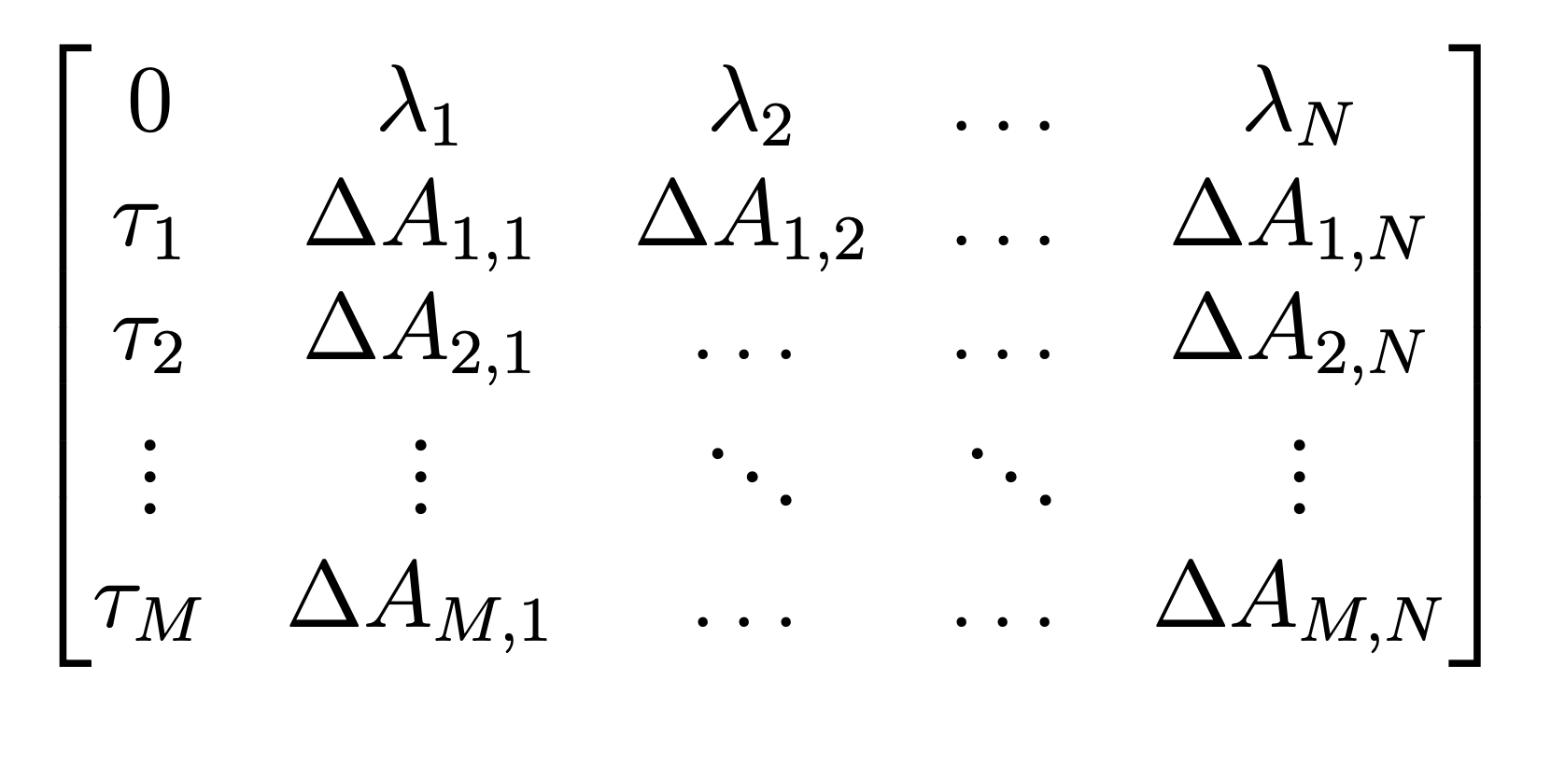
Heatmap
Upper plot
-Matrix starts as a list with zeros
-After each measurement the matrix is updates in real time
-I have to work on a toggle between current scan and total average
Lower plot
Heatmap matrix

Slide 18
Things To Add
Measurement time remaining
Scan/all scan average toggle
Wavelength calibration
Anisotropy(?)

